Slide 1
Control System Design Based on Frequency Response Analysis
Frequency response concepts and techniques play an important role in control system design and analysis.
Closed-Loop Behavior
In general, a feedback control system should satisfy the following design objectives:
Closed-loop stability
Good disturbance rejection (without excessive control action)
Fast set-point tracking (without excessive control action)
A satisfactory degree of robustness to process variations and model uncertainty
Low sensitivity to measurement noise

Slide 2
Controller Design Using Frequency Response Criteria
Advantages of FR Analysis:
1. Applicable to dynamic model of any order
(including non-polynomials).
2. Designer can specify desired closed-loop response
characteristics.
3. Information on stability and sensitivity/robustness is provided.
Disadvantage:
The approach tends to be iterative and hence time-consuming
-- interactive computer graphics desirable (MATLAB)
Chapter 14

Slide 3
Complex Variable Z-P=N Theorem
If a complex function F(s) has Z zeros and P poles inside a certain area of the s plane, the number of encirclements (N) a mapping of a closed contour around the area makes in the F plane around the origin is equal to Z-P.

Slide 5
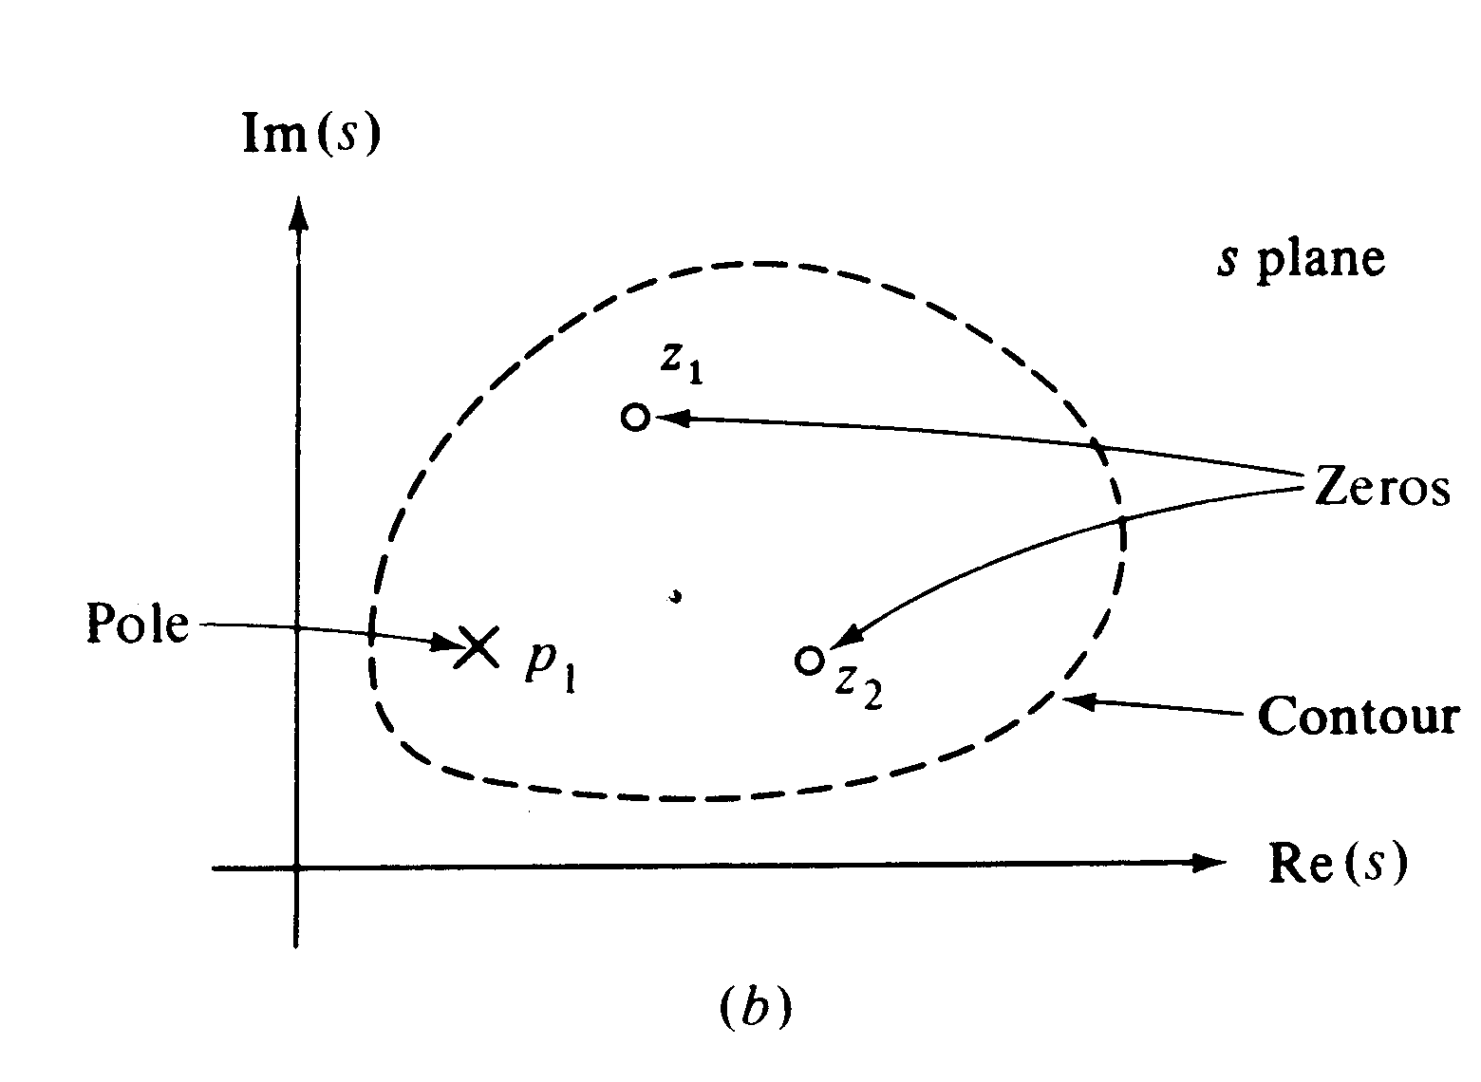

Slide 6
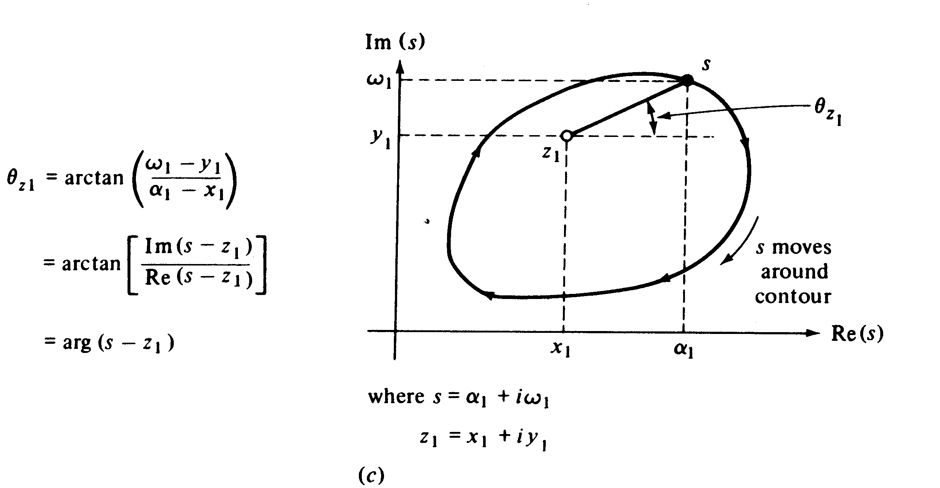

Slide 7
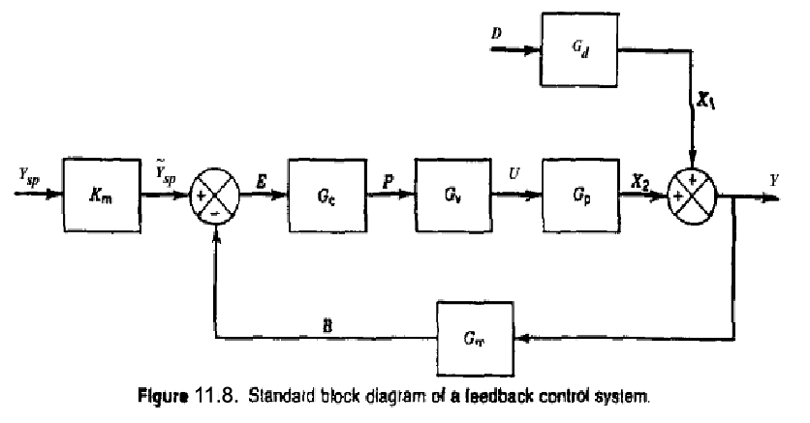
Dynamic Behavior of Closed-Loop Control Systems
4-20 mA
Chapter 11

Slide 8
Application of Z-P=N Theorem to Stability

Slide 9
Remarks

Slide 10
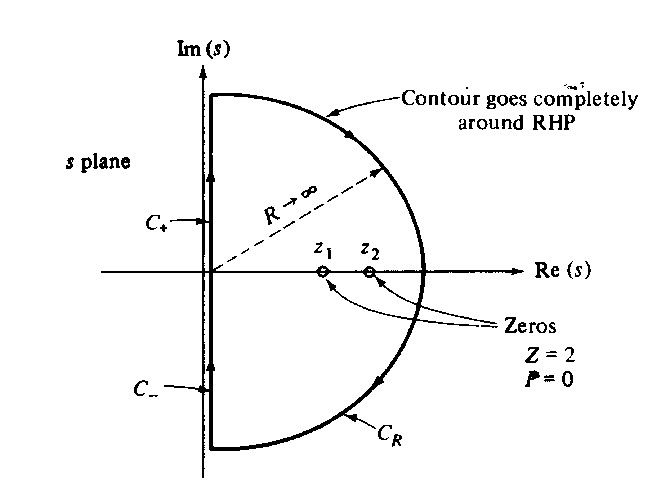

Slide 11
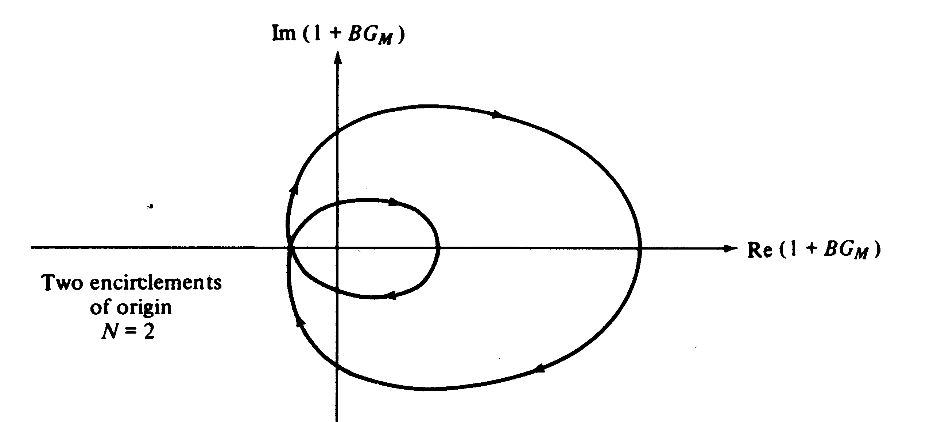

Slide 12
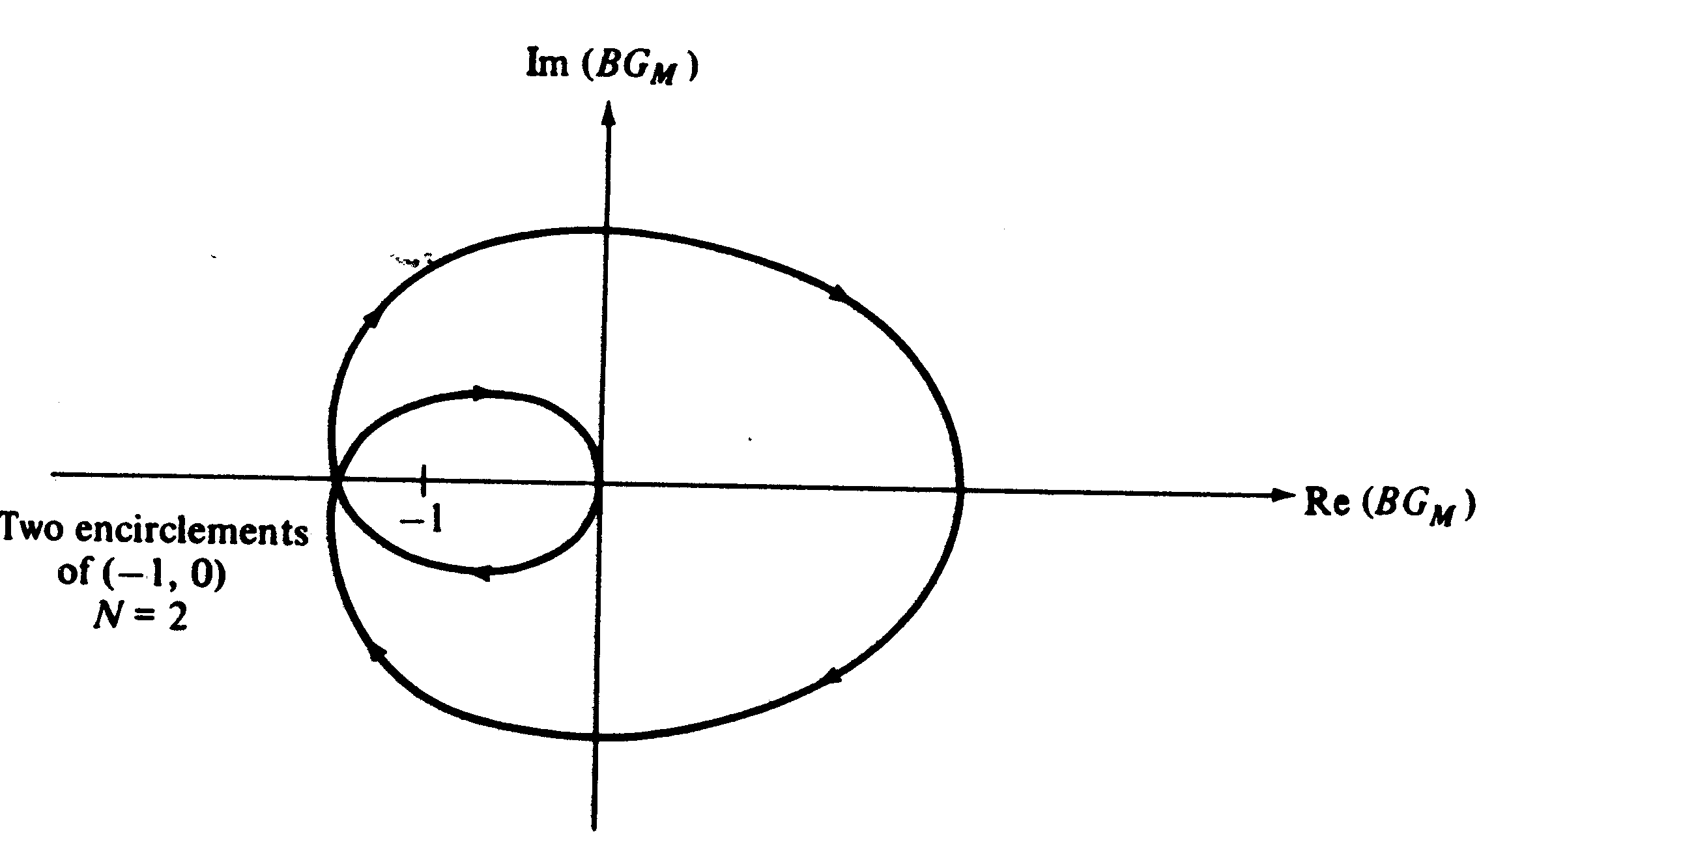

Slide 13
Nyquist Stability Criterion

Slide 14
Example

Slide 16
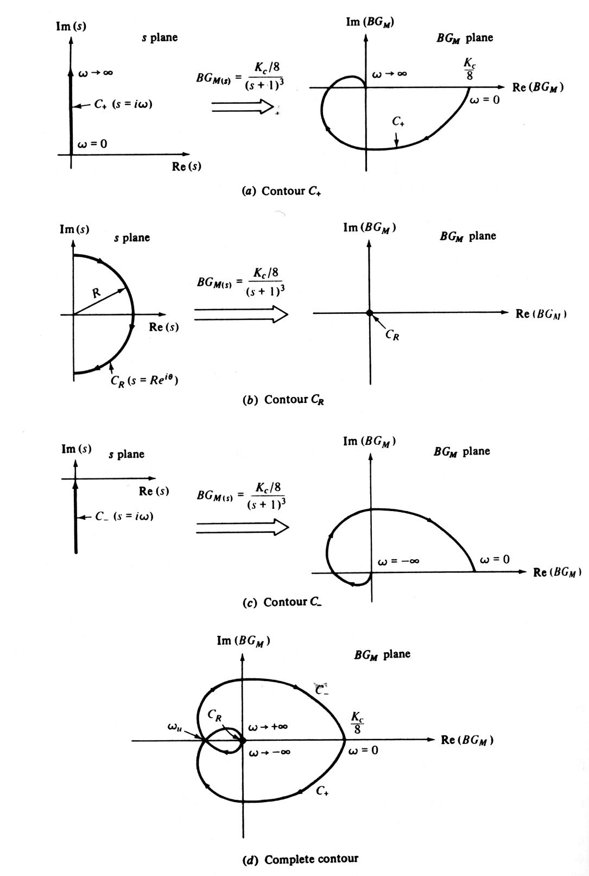

Slide 17
Important Conclusion
The C+ contour, i.e., Nyquist plot, is the only one we need to determine the system stability!

Slide 18
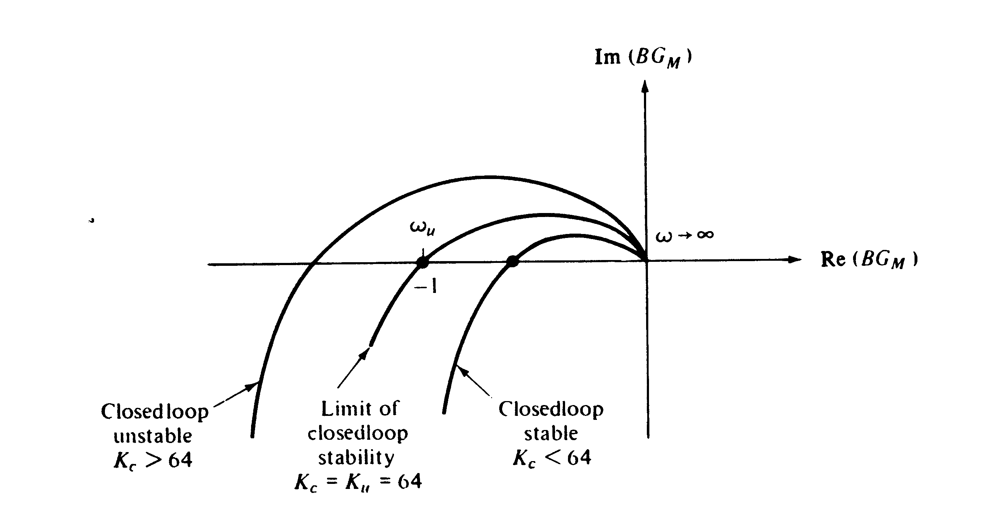

Slide 19
Ultimate Gain and Ultimate Frequency

Slide 20
Example 2

Slide 21
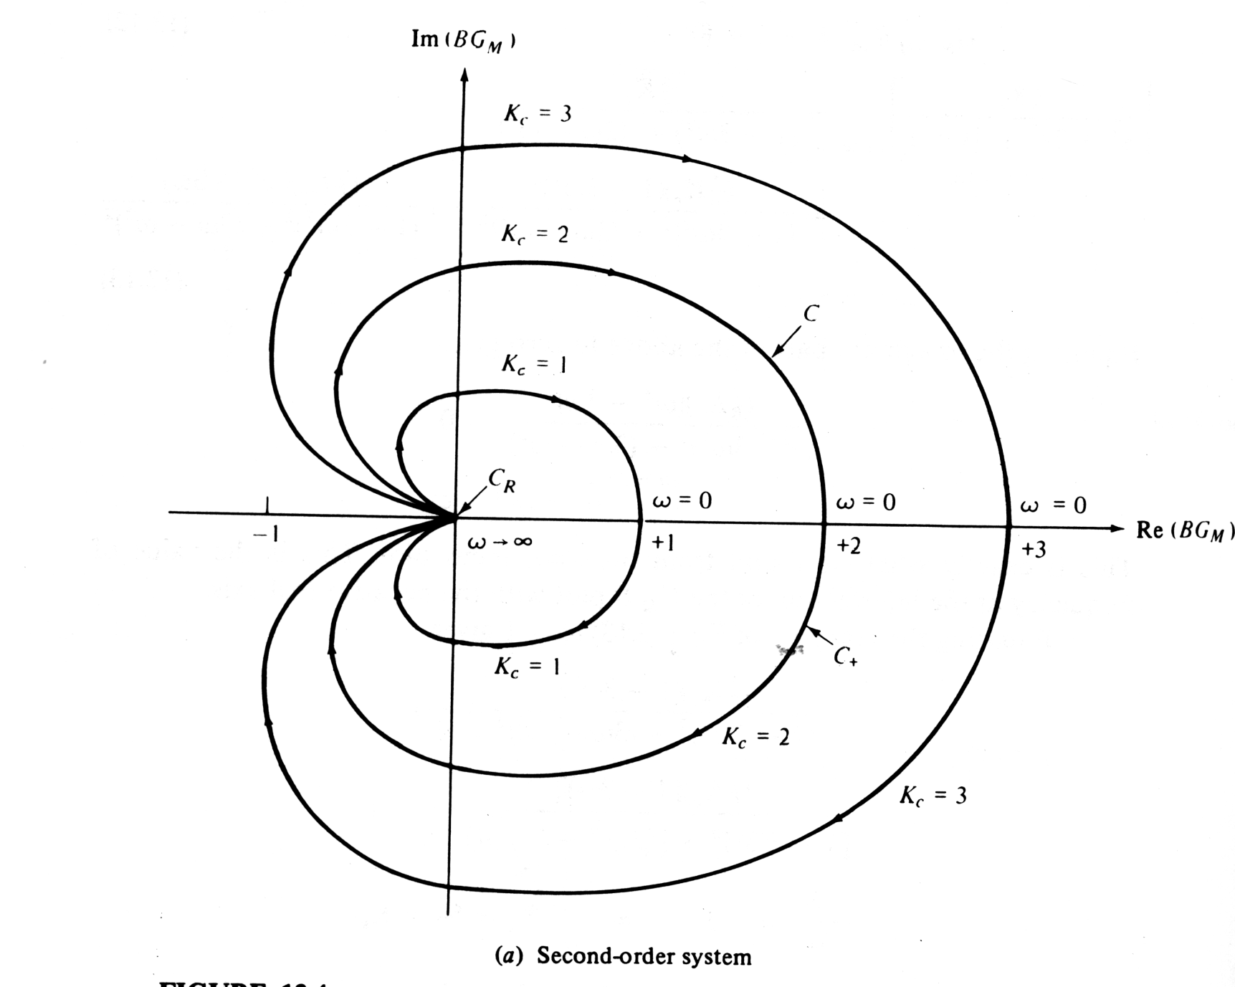
Always Stable!

Slide 22
Example 3

Slide 23
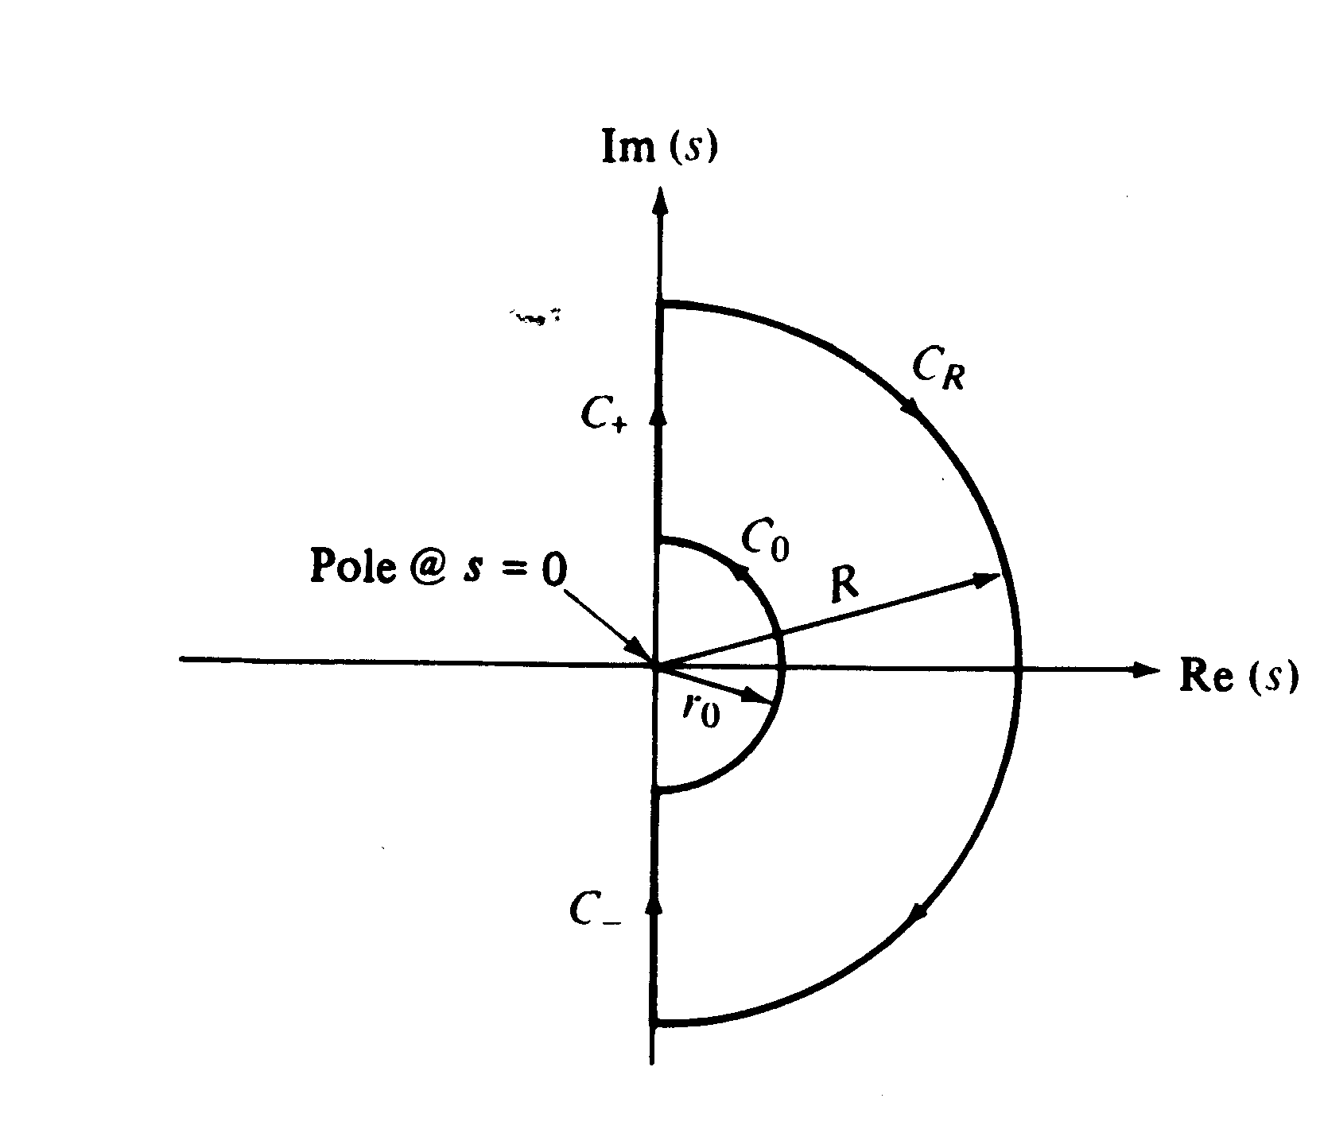

Slide 26
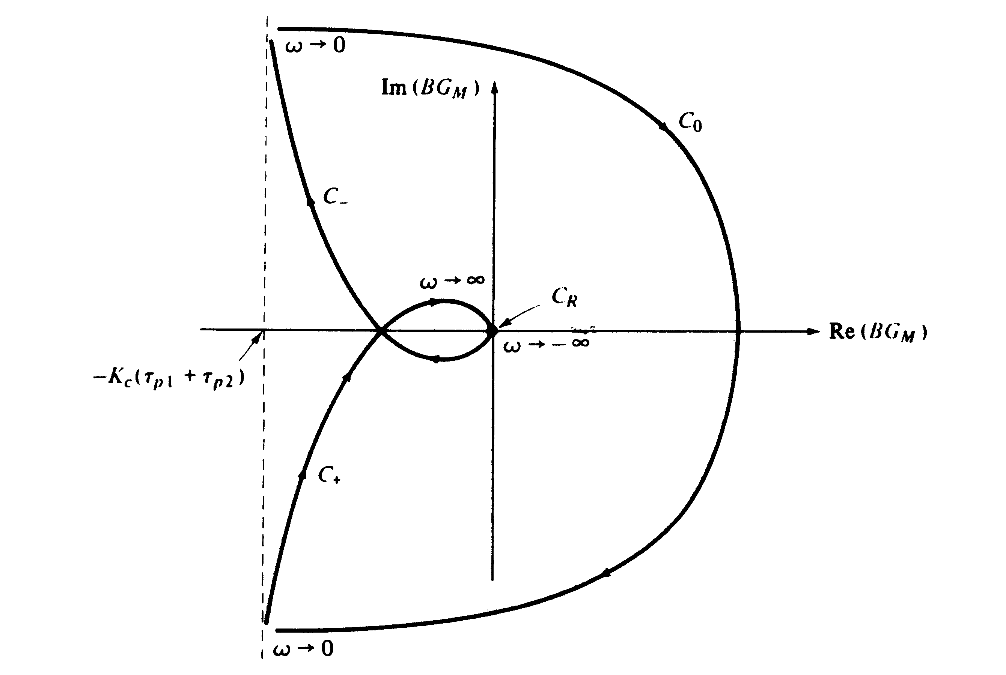

Slide 27
Example of Conditional Stability

Slide 28
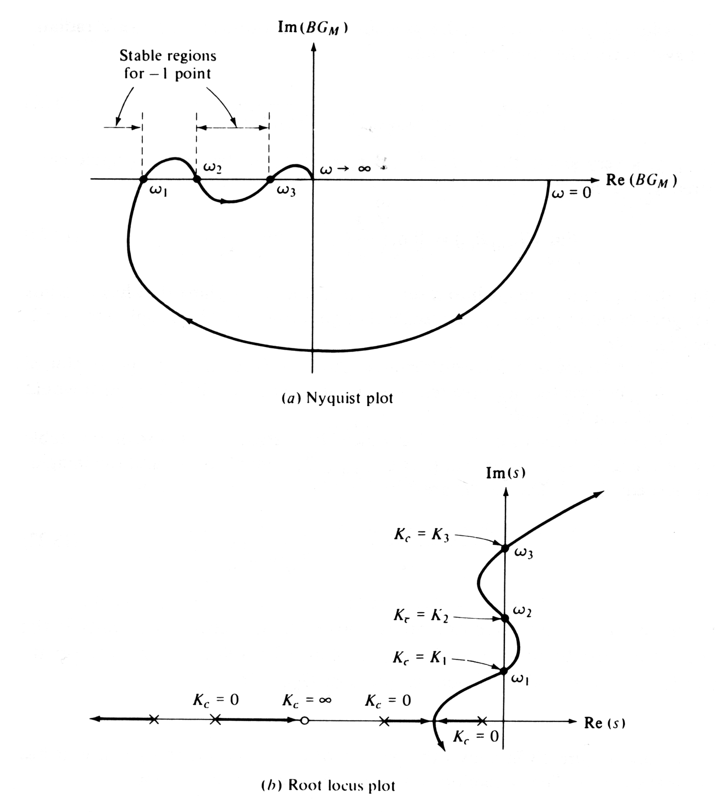

Slide 29
General Stability Criterion
A feedback control system is stable if and only if all roots of the characteristic equation lie to the left of the imaginary axis in the complex plane.

Slide 30
Stability Limits

Slide 31
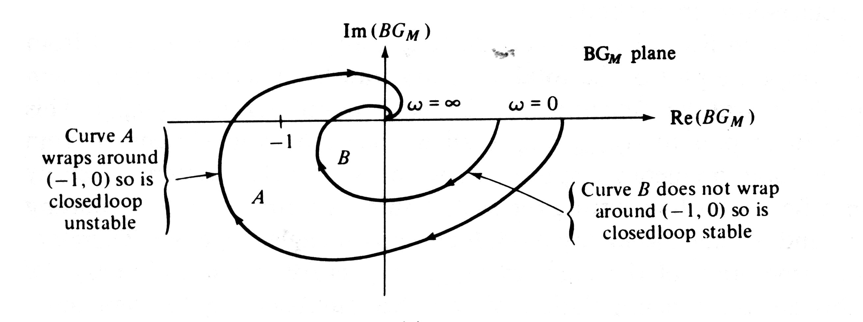

Slide 32
Critical Frequency and Gain Crossover Frequency

Slide 33
Bode Stability Criterion

Slide 34
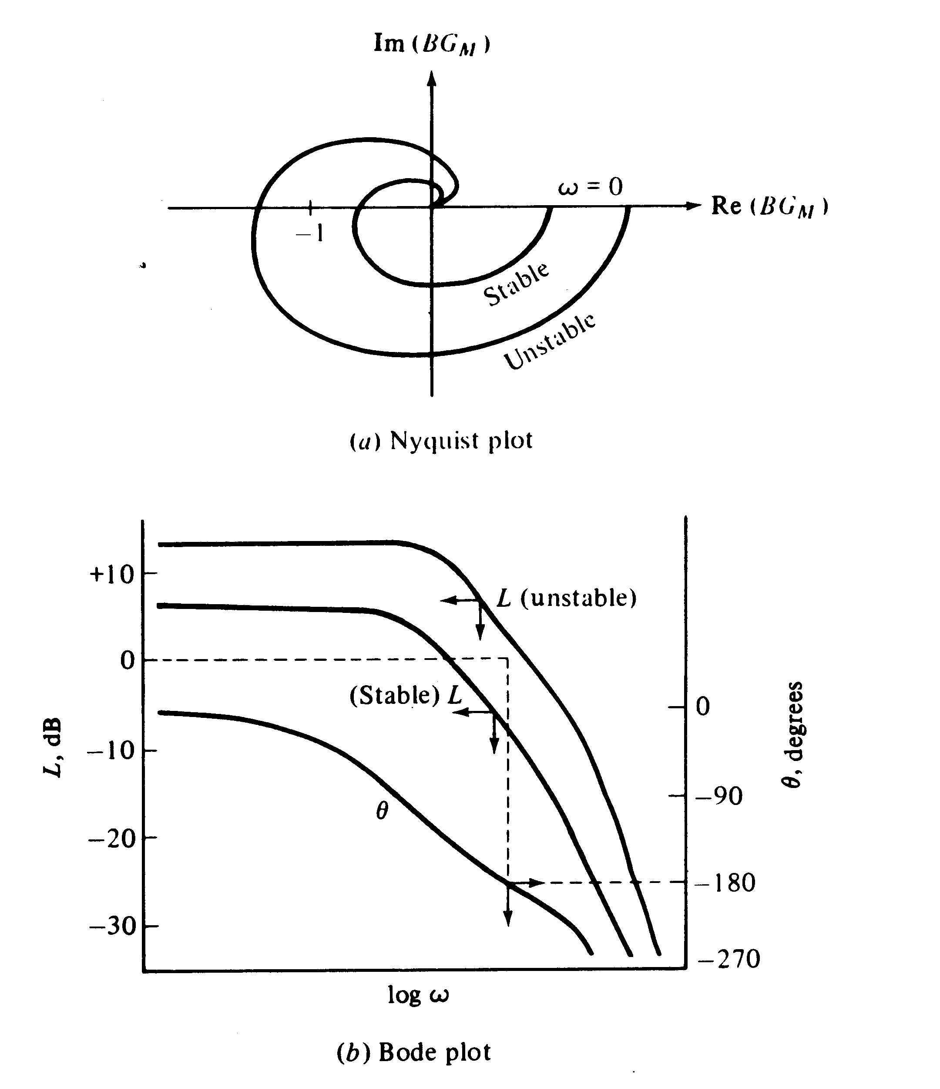

Slide 35
Advantages of Bode Stability Criterion
The Bode stability criterion has two important advantages in comparison with the Routh stability criterion of Chapter 11:
It provides exact results for processes with time delays, while the Routh stability criterion provides only approximate results due to the polynomial approximation that must be substituted for the time delay.
The Bode stability criterion provides a measure of the relative stability rather than merely a yes or no answer to the question, “Is the closed-loop system stable?”

Slide 36
Example 14.3
A process has the third-order transfer function (time constant in minutes),
Also, G_{v} = 0.1 and G_{m} = 10. For a proportional controller, evaluate the stability of the closed-loop control system using the Bode stability criterion and three values of K_{c}: 1, 4, and 20.
Solution
For this example,

Slide 37
Figure 14.5 shows a Bode plot of G_{OL} for three values of K_{c}. Note that all three cases have the same phase angle plot because the phase lag of a proportional controller is zero for K_{c} > 0.
Next, we consider the amplitude ratio AR_{OL} for each value of K_{c}. Based on Fig. 14.5, we make the following classifications:
K_{c} |  | Classification
1 | 0.25 | Stable
4 | 1 | Marginally stable
20 | 5 | Unstable

Slide 38
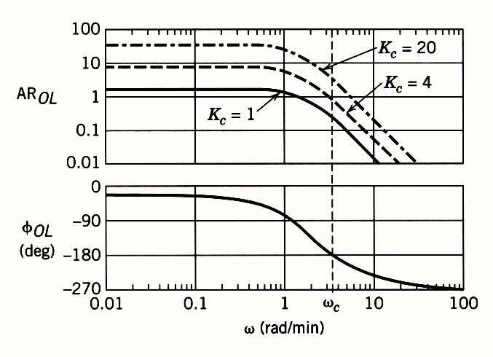
Figure 14.5 Bode plots for G_{OL} = 2K_{c}/(0.5s+1)³.

Slide 39
In Section 12.5.1 the concept of the ultimate gain was introduced. For proportional-only control, the ultimate gain K_{cu} was defined to be the largest value of K_{c} that results in a stable closed-loop system. The value of K_{cu} can be determined graphically from a Bode plot for transfer function G = G_{v}G_{p}G_{m}. For proportional-only control, G_{OL}= K_{c}G. Because a proportional controller has zero phase lag if K_{c} > 0, ω_{c} is determined solely by G. Also,
AR_{OL}(ω)=K_{c} AR_{G}(ω) (14-9)
where AR_{G} denotes the amplitude ratio of G. At the stability limit, ω = ω_{c}, AR_{OL}(ω_{c}) = 1 and K_{c}= K_{cu}. Substituting these expressions into (14-9) and solving for K_{cu} gives an important result:
The stability limit for K_{c} can also be calculated for PI and PID controllers, as demonstrated by Example 14.4.

Slide 40
Example

Slide 41
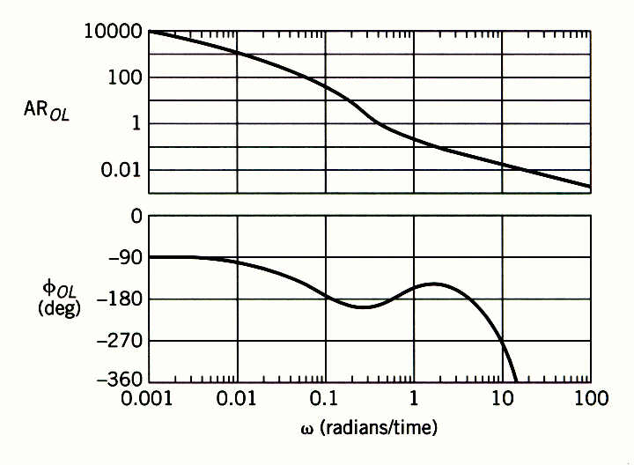
For many control problems, there is only a single and a single . But multiple values can occur, as shown in Fig. 14.3 for .
Figure 14.3 Bode plot exhibiting multiple critical frequencies.

Slide 42
Nyquist Stability Criterion

Slide 43
Important Properties of the Nyquist Stability Criterion

Slide 44
Important Properties of the Nyquist Stability Criterion
A negative value of N indicates that the -1 point is encircled in the opposite direction (counter-clockwise). This situation implies that each countercurrent encirclement can stabilize one unstable pole of the open-loop system.
Unlike the Bode stability criterion, the Nyquist stability criterion is applicable to open-loop unstable processes.
Unlike the Bode stability criterion, the Nyquist stability criterion can be applied when multiple values of critical frequencies or gain cross-over ferquencies occur.

Slide 45
Example
Evaluate the stability of the closed-loop system for:
G_{v} = 2, G_{m} = 0.25, G_{c} = K_{c}
Obtain ω_{c} and K_{cu} from a Bode plot. Let K_{c} =1.5K_{cu} and
draw the Nyquist plot for the resulting open-loop system.
Notes:
45

Slide 46
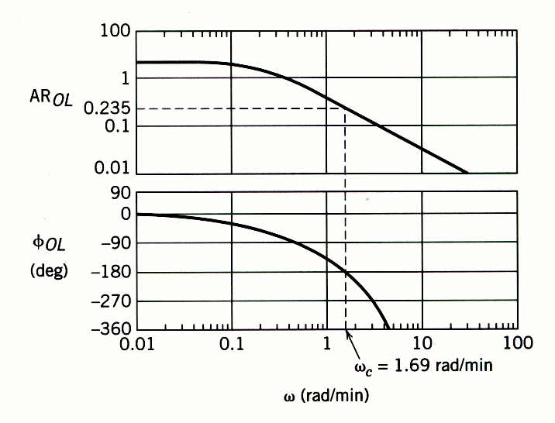
Solution
The Bode plot for G_{OL} and K_{c} = 1 is shown in Figure 14.7. For ω_{c} = 1.69 rad/min, φ_{OL} = -180° and AR_{OL} = 0.235. For K_{c} = 1, AR_{OL} = AR_{G} and K_{cu} can be calculated from Eq. 14-10. Thus, K_{cu} = 1/0.235 = 4.25. Setting K_{c} = 1.5K_{cu} gives K_{c} = 6.38.
Figure 14.7 Bode plot for Example 14.6, K_{c} = 1.
Notes:
46

Slide 47
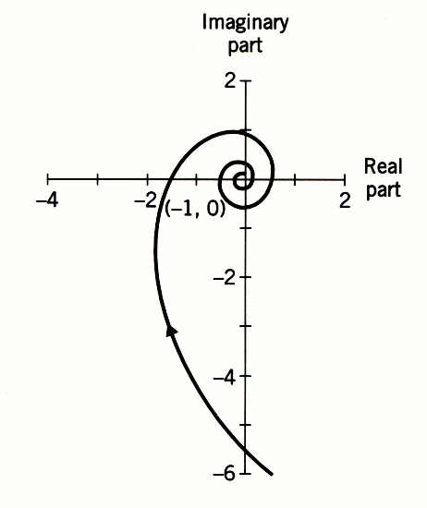
Figure 14.8 Nyquist plot for Example 14.6, K_{c} = 1.5K_{cu} = 6.38.
Notes:
47

Slide 48
Phase Margin (PM)

Slide 49
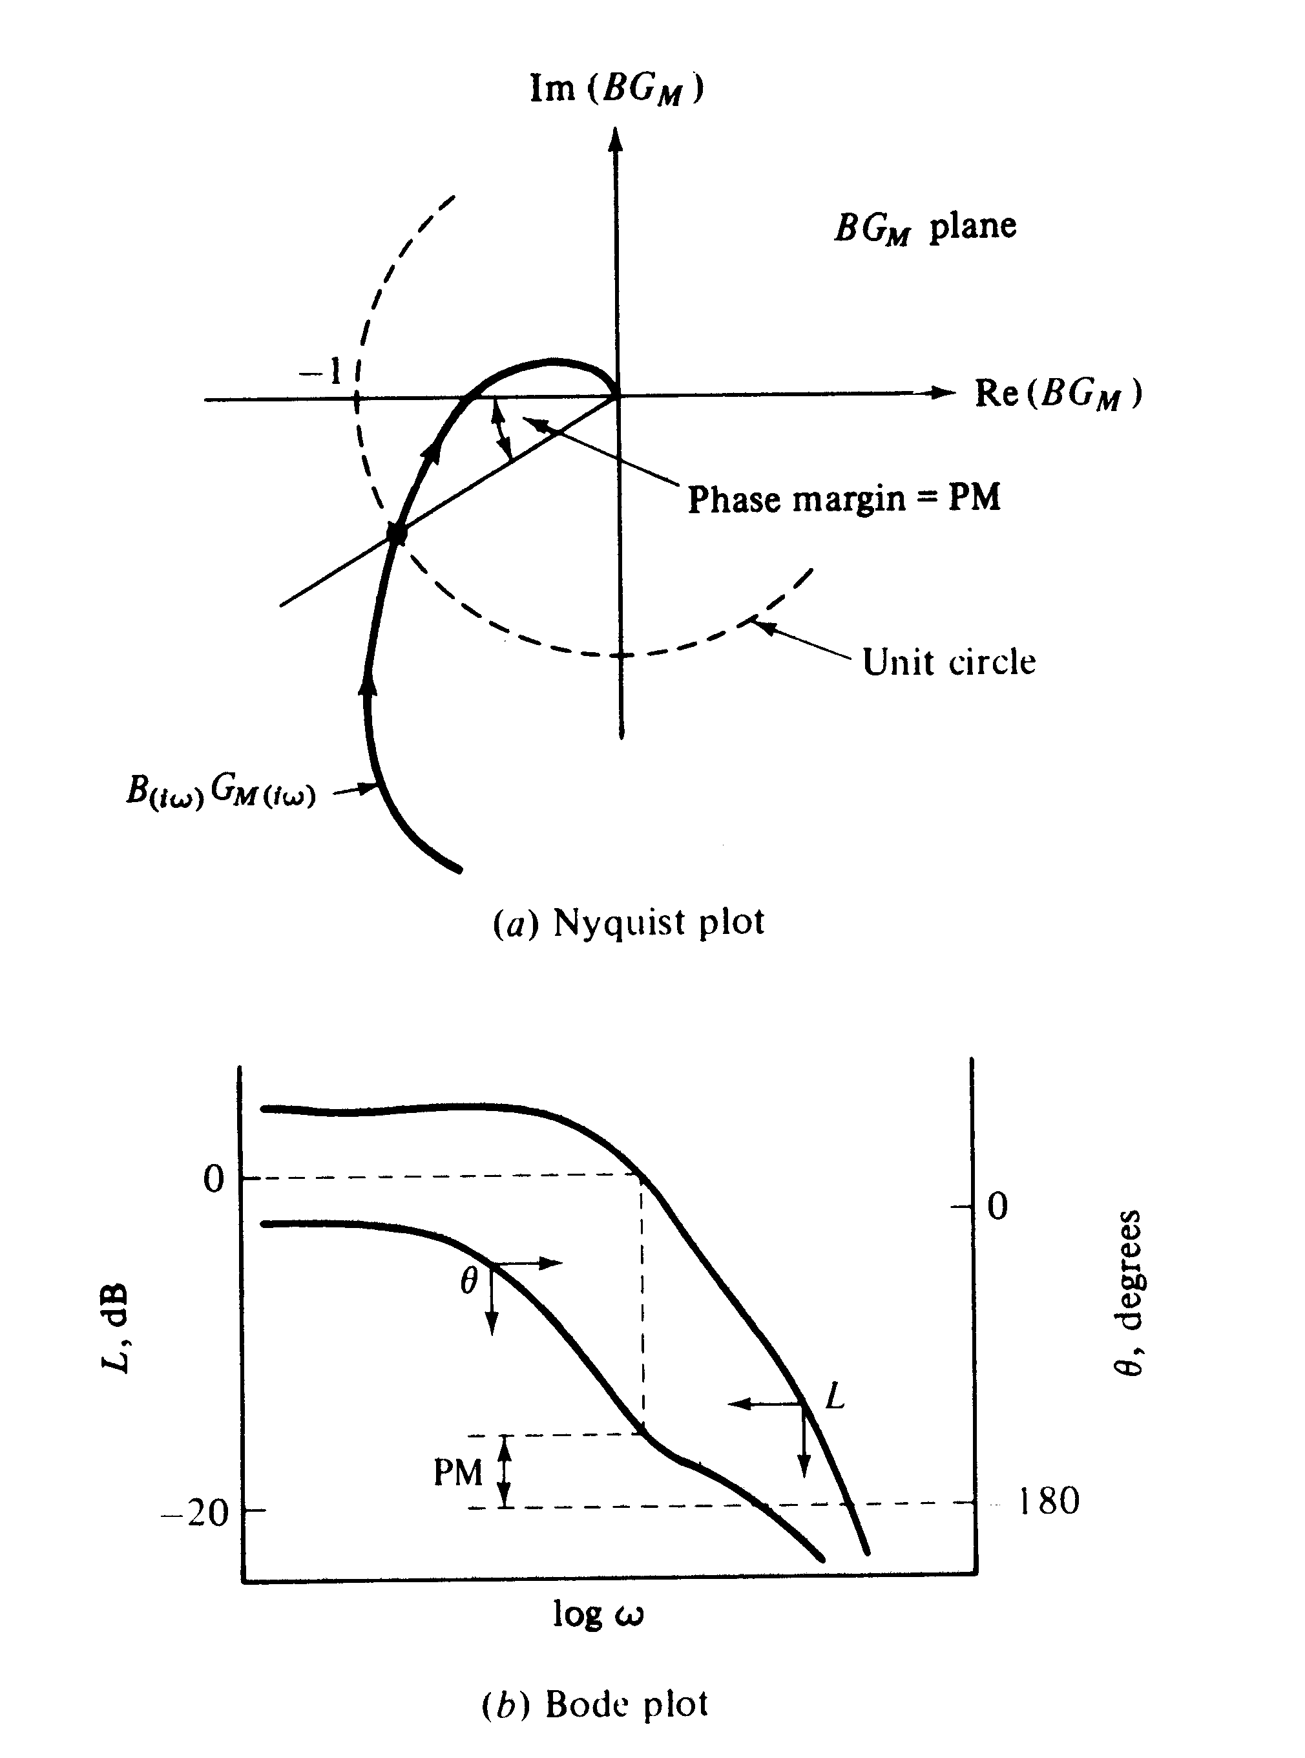

Slide 50
Gain Margin (GM)

Slide 51
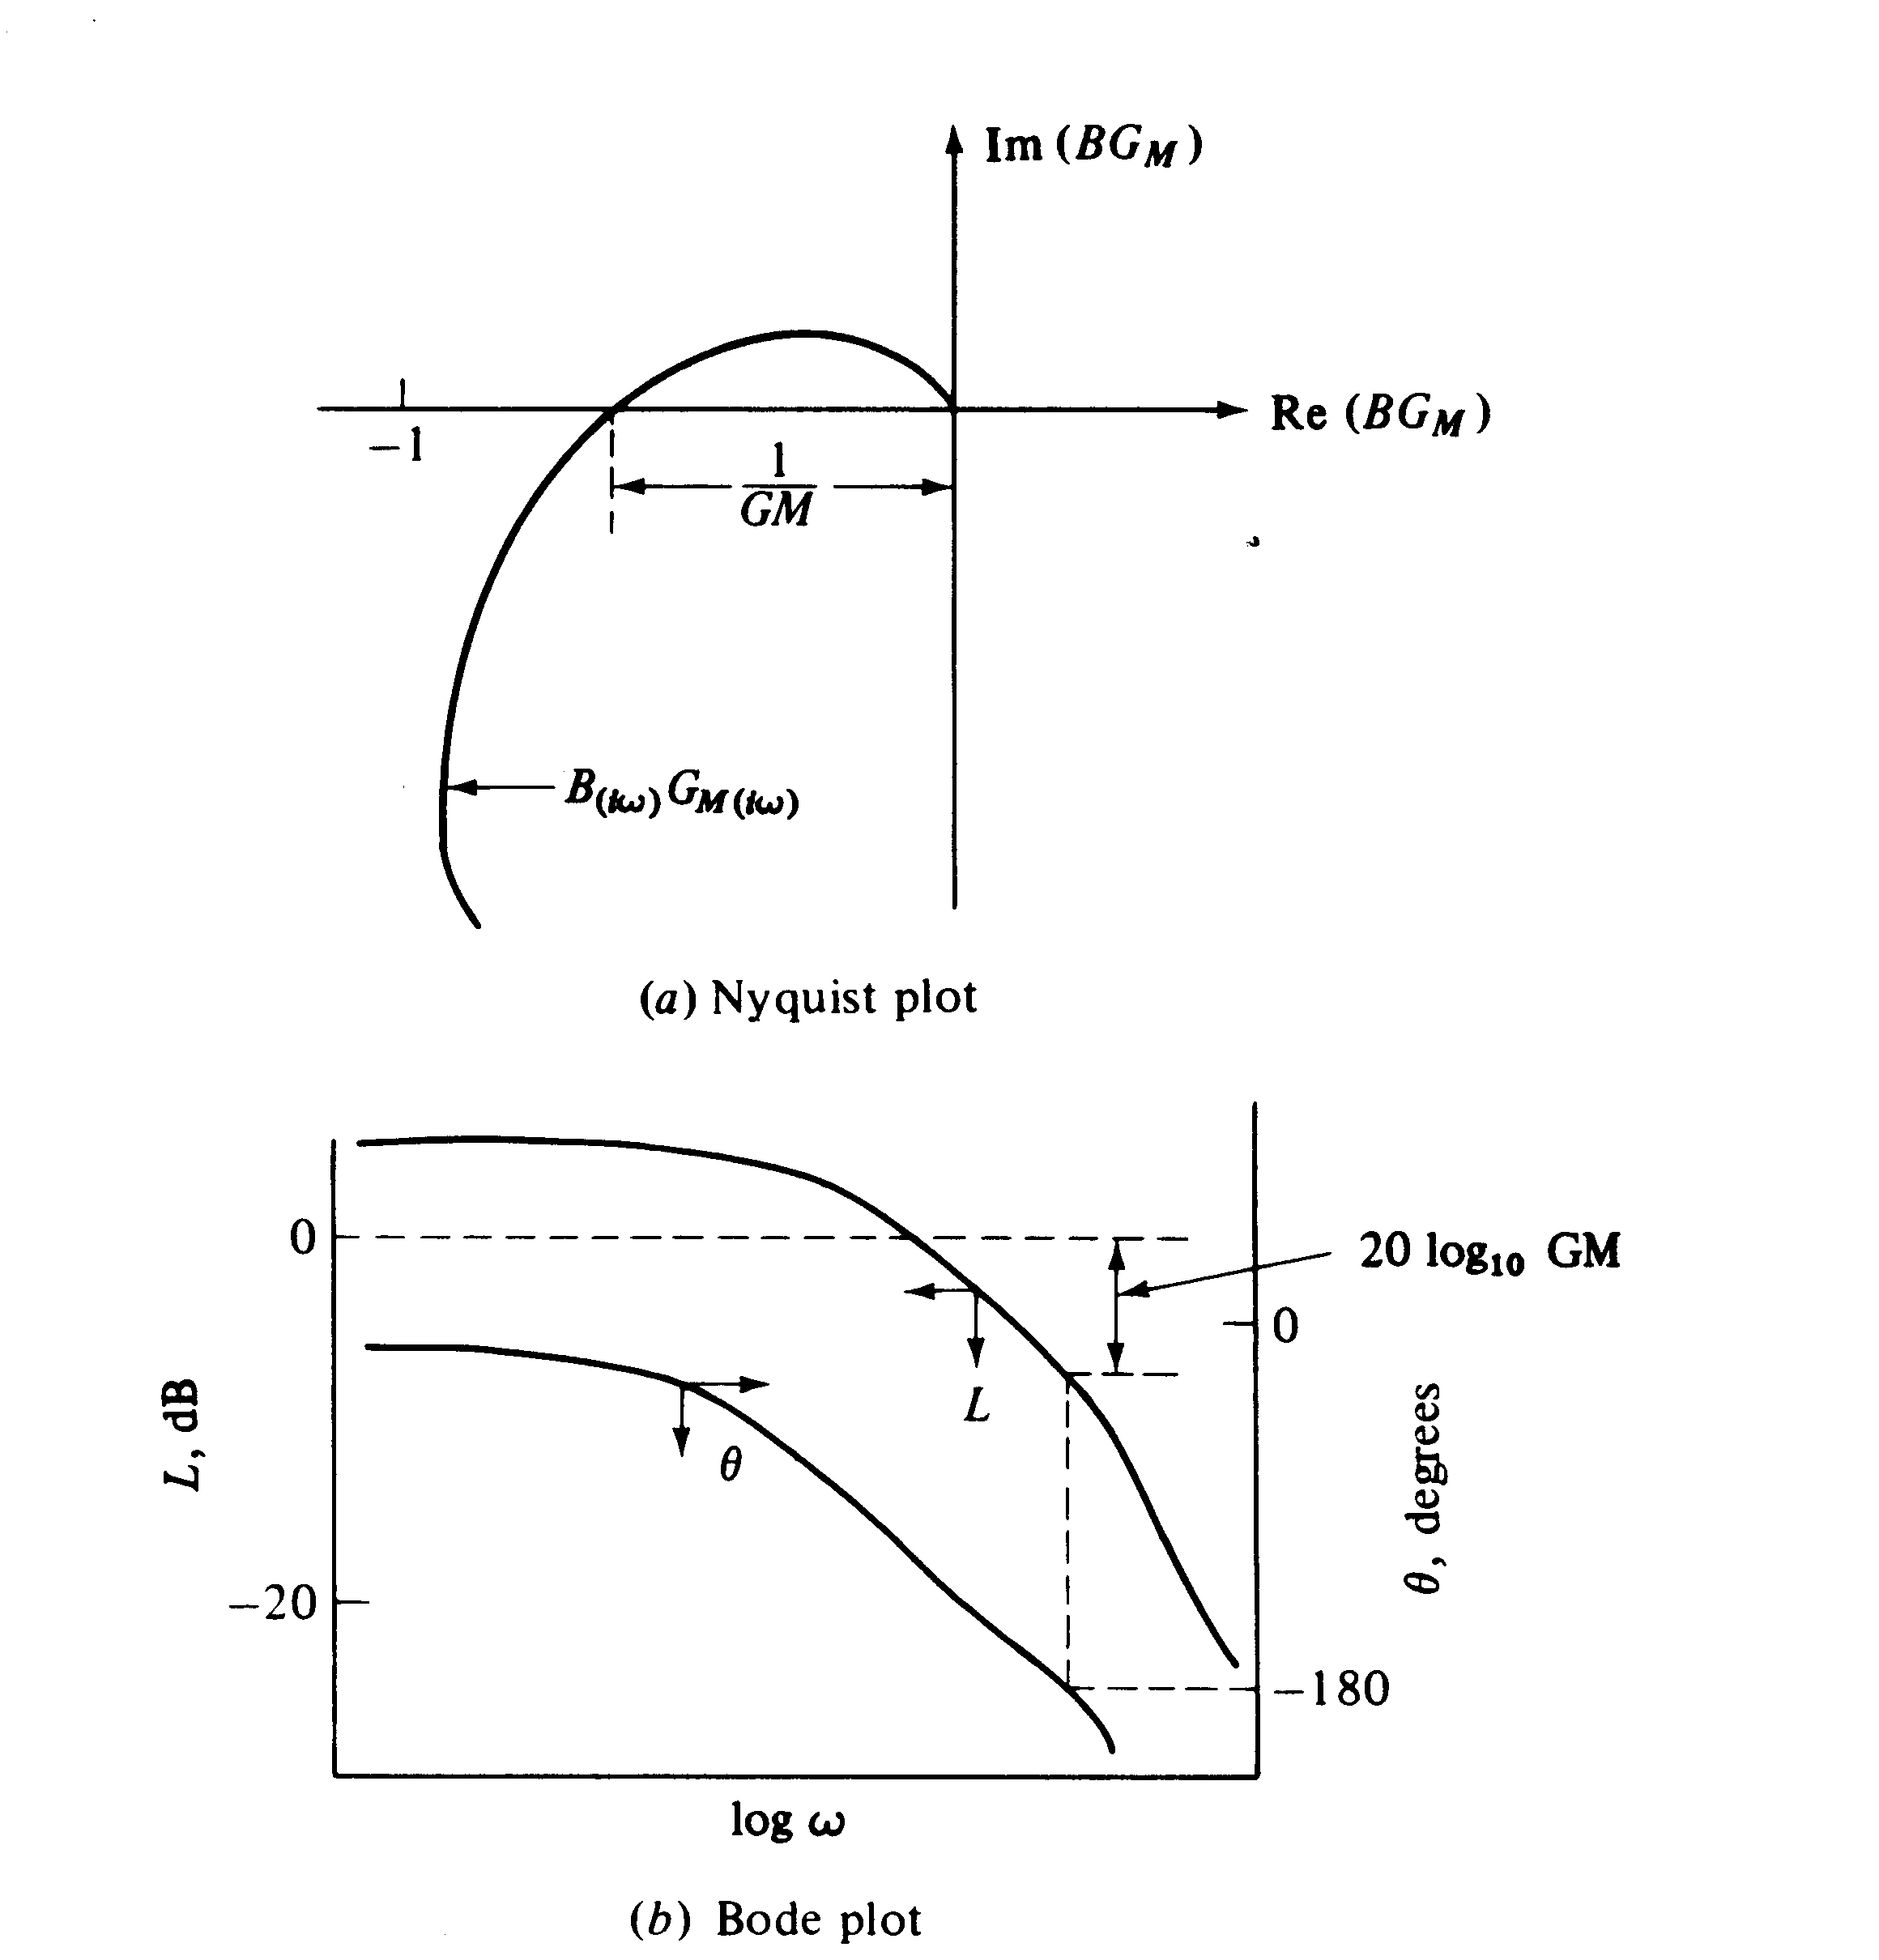

Slide 52
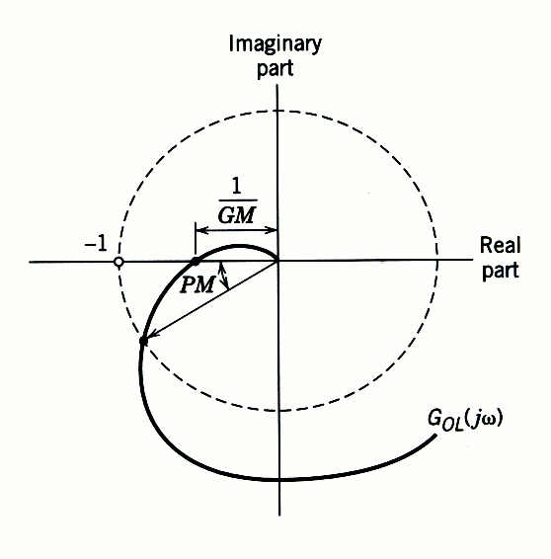
Figure 14.10 Gain and phase margins on a Nyquist plot.

Slide 53
Remarks
The phase margin also provides a measure of relative stability.
In particular, it indicates how much additional time delay can be included in the feedback loop before instability will occur.
Denote the additional time delay as .
For a time delay of , the phase angle is .

Slide 54
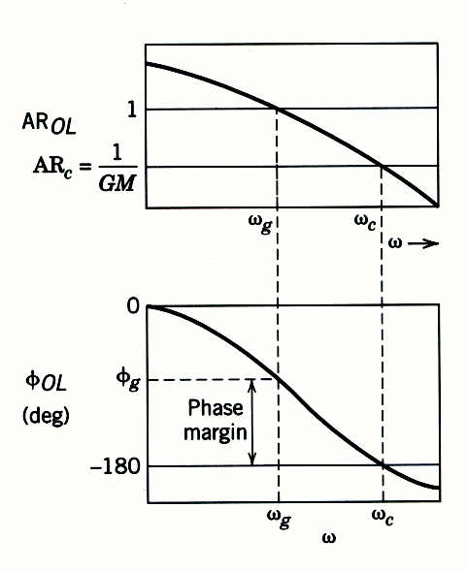
Figure 14.9 Gain and phase margins in Bode plot.

Slide 55
where the factor converts PM from degrees to radians.
The specification of phase and gain margins requires a compromise between performance and robustness.
In general, large values of GM and PM correspond to sluggish closed-loop responses, while smaller values result in less sluggish, more oscillatory responses.

Slide 56
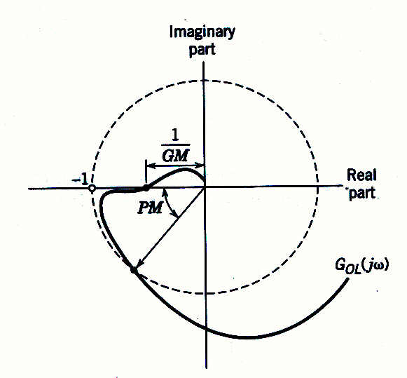
Figure 14.12 Nyquist plot where the gain and phase margins are misleading.
Notes:
56

Slide 57
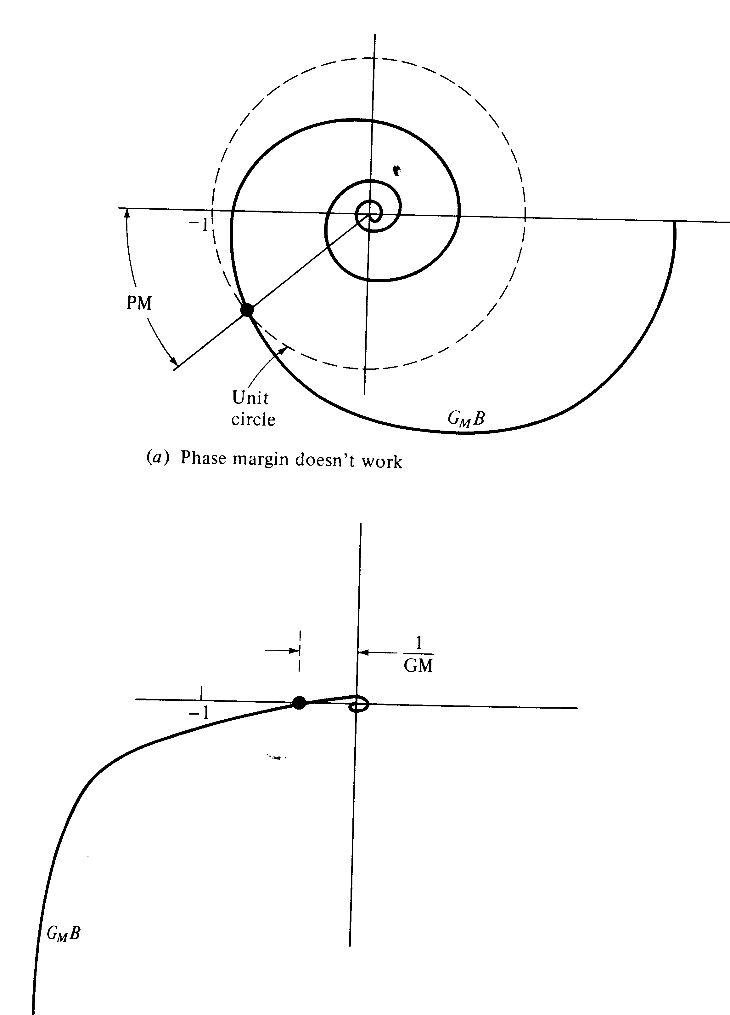
(b) Gain margin doesn’t work.

Slide 58
Closed-Loop Frequency Response and Sensitivity Functions
Sensitivity Functions
Define G as and assume that G_{m}=K_{m} and G_{d} = 1. Two important concepts are now defined:
Notes:
58

Slide 59
S is the closed-loop transfer function for disturbances (Y/D), while T is the closed-loop transfer function for set-point changes (Y/Y_{sp}). It is easy to show that:
S and T provide measures of how sensitive the closed-loop system is to changes in the process.
Let |S(j )| and |T(j )| denote the amplitude ratios of S and T, respectively.
The maximum values of the amplitude ratios provide useful measures of robustness.
They also serve as control system design criteria.
Notes:
59

Slide 60
Notes:
60

Slide 61
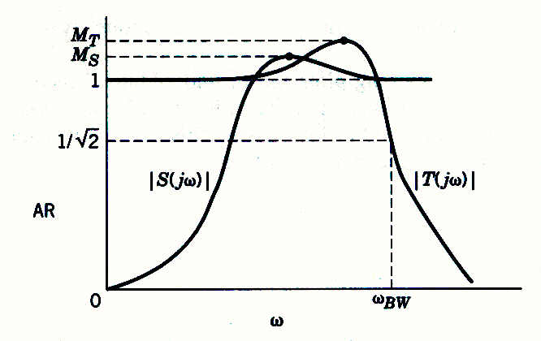
Figure 14.13 Typical S and T magnitude plots. (Modified from Maciejowski (1998)).
Guideline. For a satisfactory control system, M_{T} should be in the range 1.0 – 1.5 and M_{S} should be in the range of 1.2 – 2.0.
Notes:
61

Slide 62
Integral Action

Slide 63
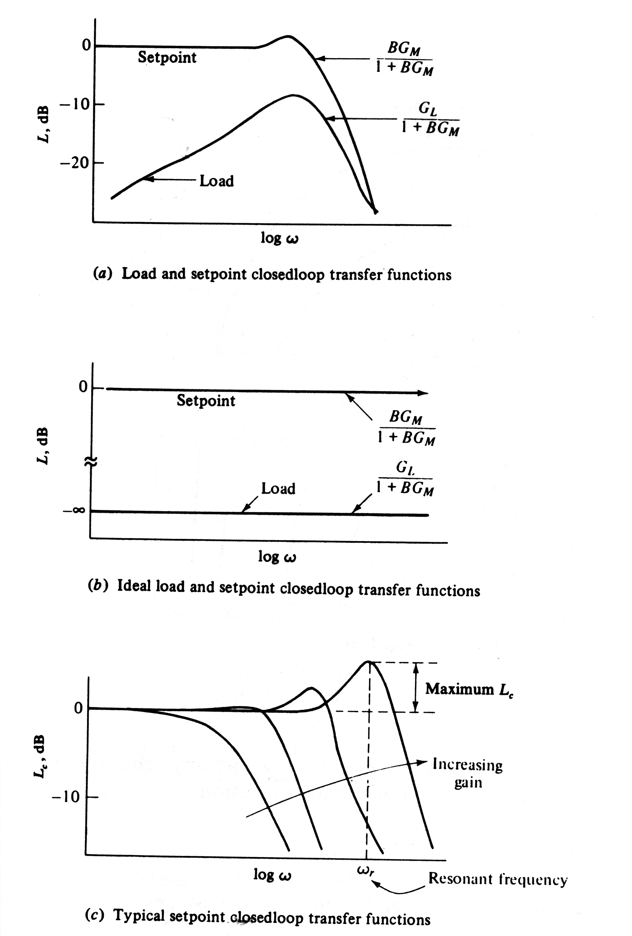

Slide 64
Lower Bounds of GM and PM
It is easy to prove that M_{S} and M_{T} are related to the gain and phase margins (Morari and Zafiriou, 1989):
Notes:
64

Slide 65
Bandwidth
A typical amplitude ratio plot for T and the corresponding set-point response are shown in Fig. 14.14.
The definition, the bandwidth ω_{BW} is defined as the frequency at which |T(jω)| = 0.707.
The bandwidth indicates the frequency range for which satisfactory set-point tracking occurs. In particular, ω_{BW} is the maximum frequency for a sinusoidal set point to be attenuated by no more than a factor of 0.707.
The bandwidth is also related to speed of response.
In general, the bandwidth is (approximately) inversely proportional to the closed-loop settling time.
Notes:
65

Slide 66
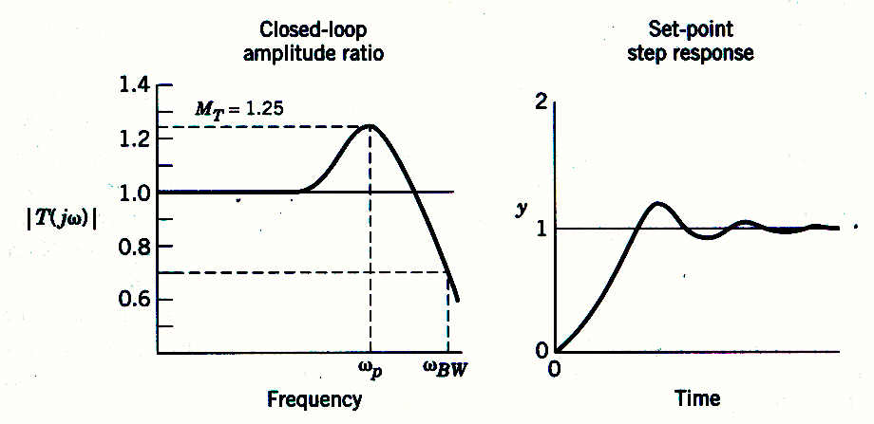
Figure 14.14 Typical closed-loop amplitude ratio |T(jω)| and set-point response.
Notes:
66

Slide 67
Closed-loop Performance Criteria
Ideally, a feedback controller should satisfy the following criteria.
In order to eliminate offset, |T(jω)|→ 1 as ω  0.
|T(jω)| should be maintained at unity up to as high as frequency as possible. This condition ensures a rapid approach to the new steady state during a set-point change.
As indicated in the Guideline, M_{T} should be selected so that 1.0 < M_{T} < 1.5.
The bandwidth ω_{BW} and the frequency ω_{T} at which M_{T} occurs, should be as large as possible. Large values result in the fast closed-loop responses.
The closed-loop frequency response can be calculated analytically from the open-loop frequency response.
Notes:
67

Slide 68
Nichols Chart

Slide 69
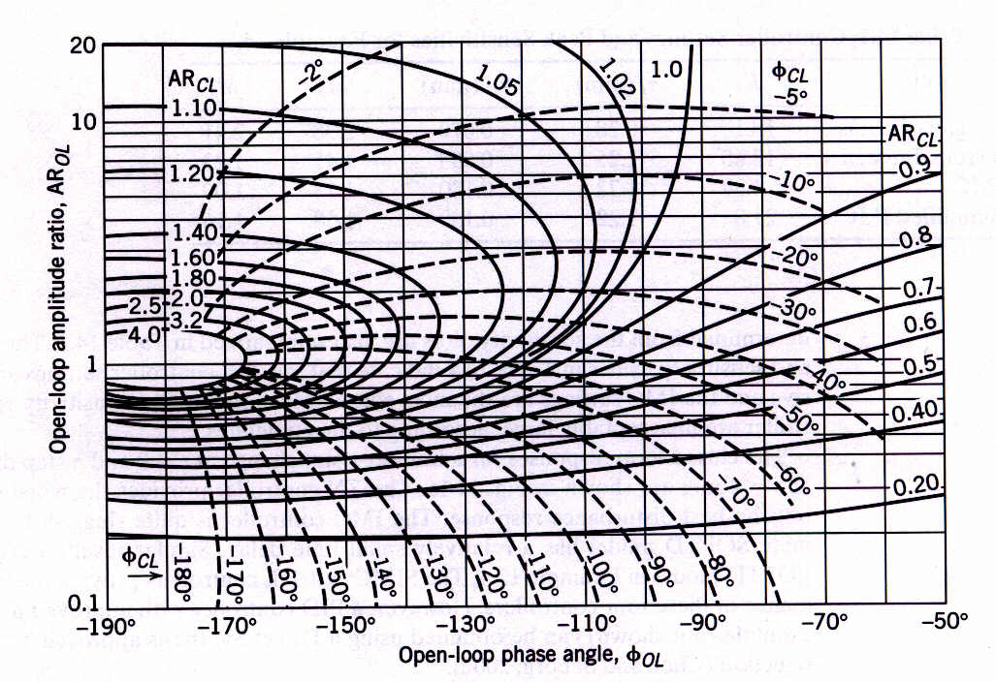
Figure 14.15 A Nichols chart. [The closed-loop amplitude ratio AR_{CL} ( ) and phase angle are shown in families of curves.]
Notes:
69

Slide 70
Maximum Closed-Loop Log Modulus (LM)

Slide 71
Example

Slide 72
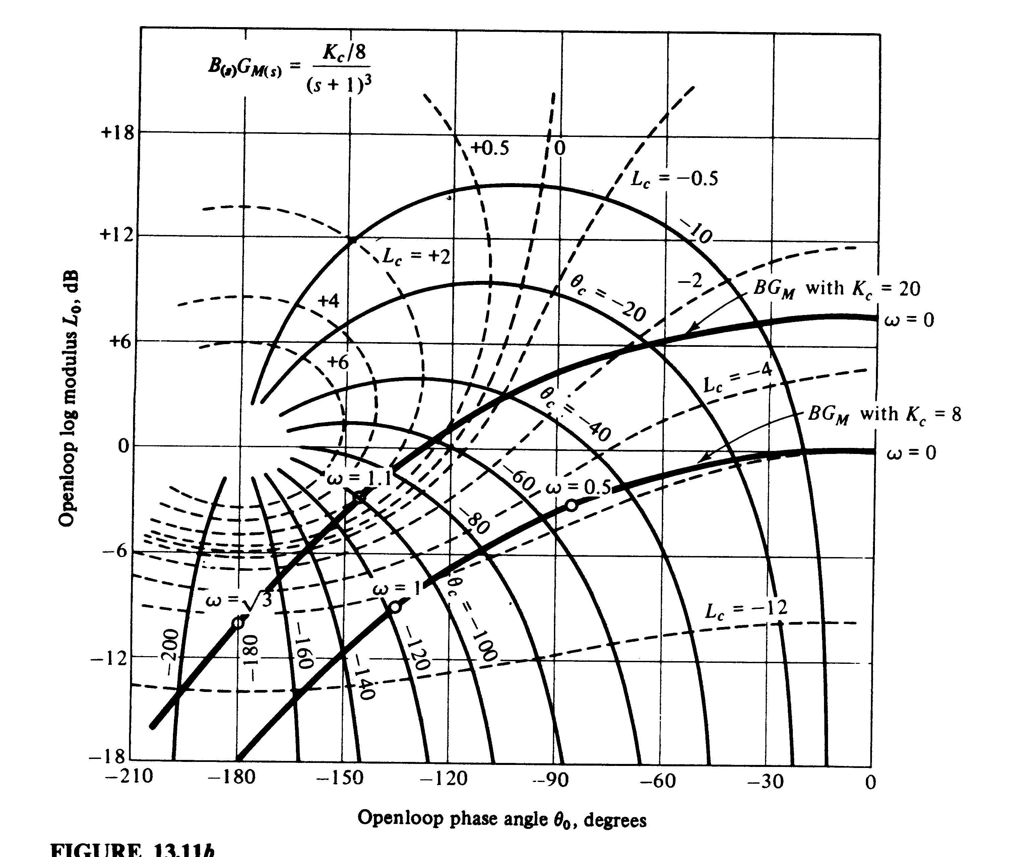

Slide 73
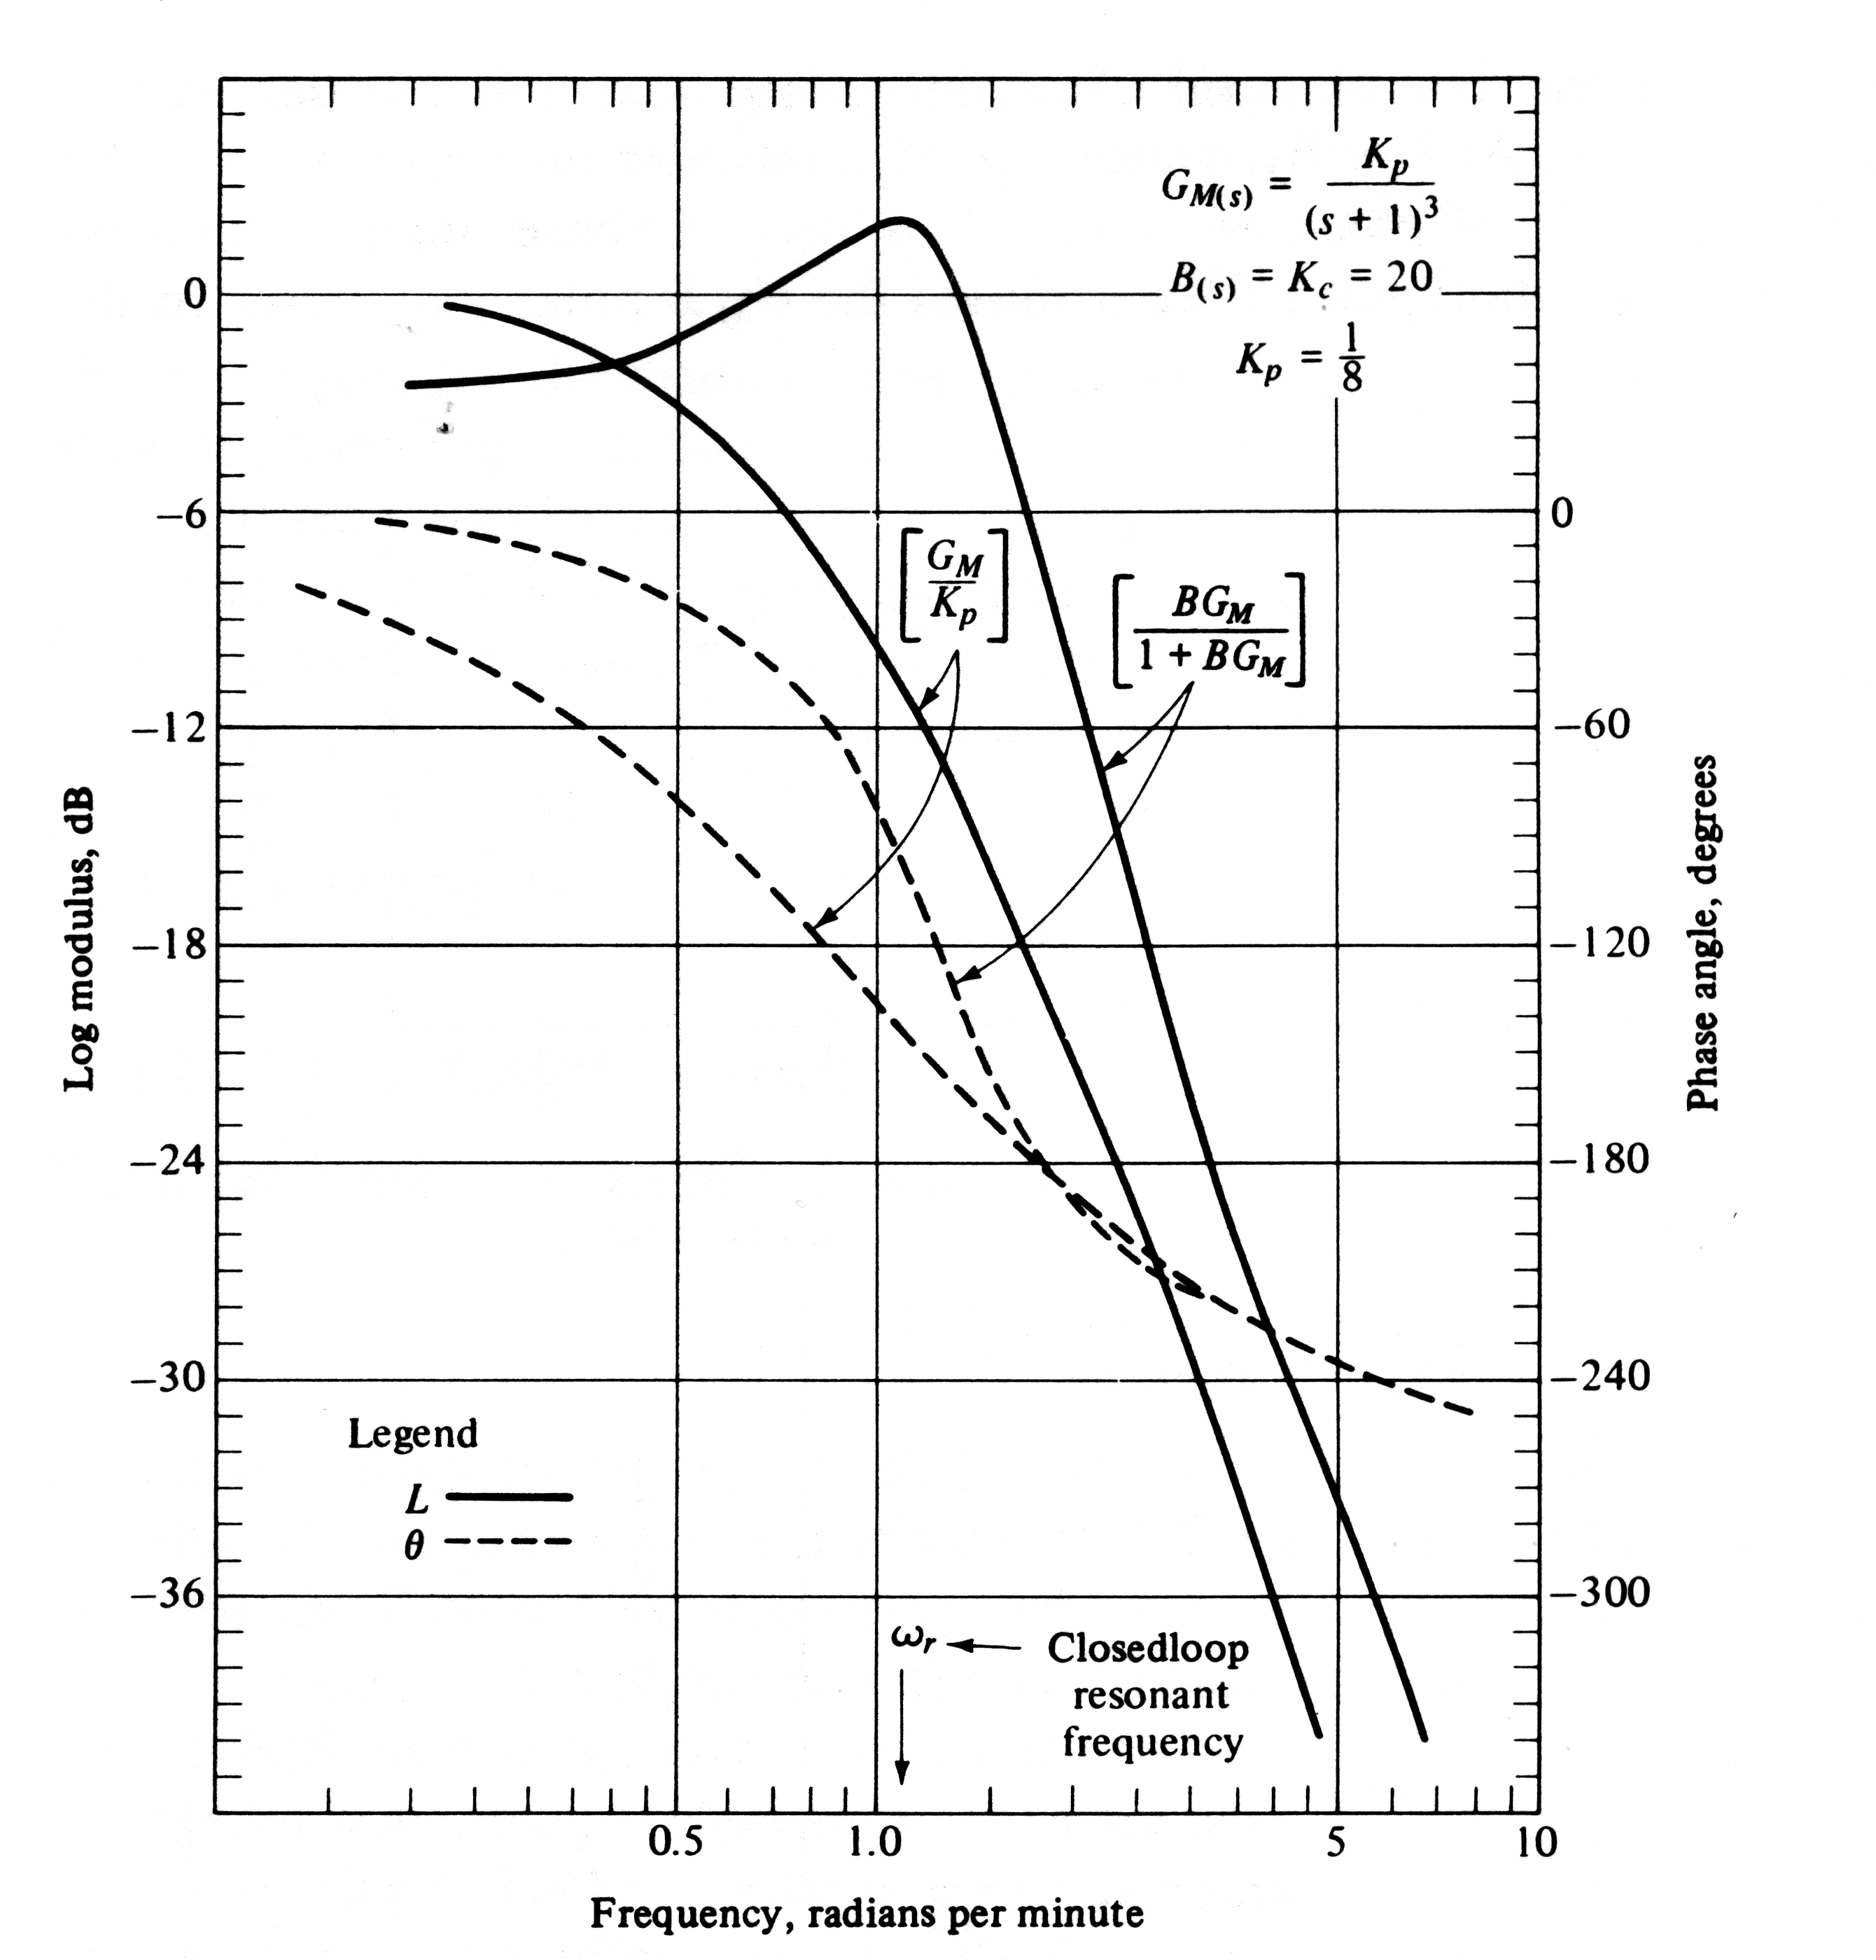

Slide 74
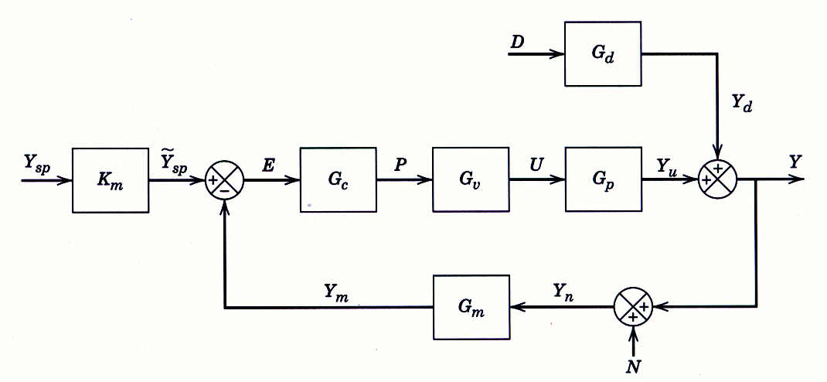
Figure 14.1 Block diagram with a disturbance D and measurement noise N.

Slide 75
The block diagram of a general feedback control system is shown in Fig. 14.1.
It contains three external input signals: set point Y_{sp}, disturbance D, and additive measurement noise, N.
where G G_{v}G_{p}G_{m}.

Slide 76
Example 14.1
Consider the feedback system in Fig. 14.1 and the following transfer functions:
Suppose that controller G_{c} is designed to cancel the unstable pole in G_{p}:
Evaluate closed-loop stability and characterize the output response for a sustained disturbance.

Slide 77
Solution
The characteristic equation, 1 + G_{c}G = 0, becomes:
or
In view of the single root at s = -2.5, it appears that the closed-loop system is stable. However, if we consider Eq. 14-1 for N = Y_{sp} = 0,

Slide 78
This transfer function has an unstable pole at s = +0.5. Thus, the output response to a disturbance is unstable.
Furthermore, other transfer functions in (14-1) to (14-3) also have unstable poles.
This apparent contradiction occurs because the characteristic equation does not include all of the information, namely, the unstable pole-zero cancellation.
Example 14.2
Suppose that G_{d} = G_{p}, G_{m} = K_{m} and that G_{c} is designed so that the closed-loop system is stable and |GG_{c} | >> 1 over the frequency range of interest. Evaluate this control system design strategy for set-point changes, disturbances, and measurement noise. Also consider the behavior of the manipulated variable, U.

Slide 79
Solution
Because |GG_{c} | >> 1,
The first expression and (14-1) suggest that the output response to disturbances will be very good because Y/D ≈ 0. Next, we consider set-point responses. From Eq. 14-1,
Because G_{m} = K_{m}, G = G_{v}G_{p}K_{m} and the above equation can be written as,

Slide 80
For |GG_{c} | >> 1,
Thus, ideal (instantaneous) set-point tracking would occur. Choosing G_{c} so that |GG_{c}| >> 1 also has an undesirable consequence. The output Y becomes sensitive to noise because Y ≈ - N (see the noise term in Eq. 14-1). Thus, a design tradeoff is required.

Slide 81
Example 14.8
Consider a fourth-order process with a wide range of time constants that have units of minutes (Åström et al., 1998):
Calculate PID controller settings based on following tuning relations in Chapter 12
Ziegler-Nichols tuning (Table 12.6)
Tyreus-Luyben tuning (Table 12.6)
IMC Tuning with (Table 12.1)
Simplified IMC (SIMC) tuning (Table 12.5) and a second-order plus time-delay model derived using Skogestad’s model approximation method (Section 6.3).

Slide 82
Determine sensitivity peaks M_{S} and M_{T} for each controller. Compare the closed-loop responses to step changes in the set-point and the disturbance using the parallel form of the PID controller without a derivative filter:
Assume that G_{d}(s) = G(s).

Slide 83
Controller Settings for Example 14.8
Controller | K_{c} |  |  | M_{S} | M_{T}
Ziegler-Nichols | 18.1 | 0.28 | 0.070 | 2.38 | 2.41
Tyreus-Luyben | 13.6 | 1.25 | 0.089 | 1.45 | 1.23
IMC | 4.3 | 1.20 | 0.167 | 1.12 | 1.00
Simplified IMC | 21.8 | 1.22 | 0.180 | 1.58 | 1.16

Slide 84
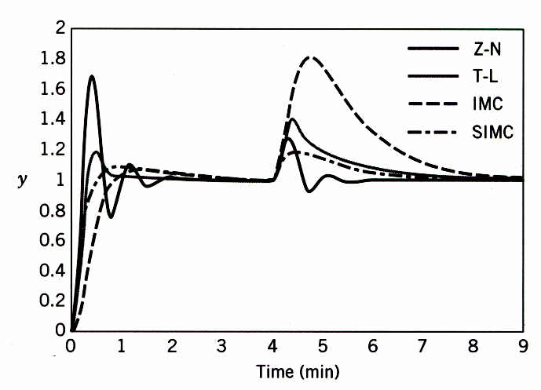
Figure 14.16 Closed-loop responses for Example 14.8. (A set-point change occurs at t = 0 and a step disturbance at t = 4 min.)

Slide 85
Robustness Analysis
In order for a control system to function properly, it should not be unduly sensitive to small changes in the process or to inaccuracies in the process model, if a model is used to design the control system.
A control system that satisfies this requirement is said to be robust or insensitive.
It is very important to consider robustness as well as performance in control system design.
First, we explain why the S and T transfer functions in Eq. 14-15 are referred to as “sensitivity functions”.

Slide 86
Sensitivity Analysis
In general, the term sensitivity refers to the effect that a change in one transfer function (or variable) has on another transfer function (or variable).
Suppose that G changes from a nominal value G_{p0} to an arbitrary new value, G_{p0} + dG.
This differential change dG causes T to change from its nominal value T₀ to a new value, T₀ + dT.
Thus, we are interested in the ratio of these changes, dT/dG, and also the ratio of the relative changes:

Slide 87
We can write the relative sensitivity in an equivalent form:
The derivative in (14-26) can be evaluated after substituting the definition of T in (14-15b):
Substitute (14-27) into (14-26). Then substituting the definition of S in (14-15a) and rearranging gives the desired result:

Slide 88
Equation 14-28 indicates that the relative sensitivity is equal to S.
For this reason, S is referred to as the sensitivity function.
In view of the important relationship in (14-16), T is called the complementary sensitivity function.
Effect of Feedback Control on Relative Sensitivity
Next, we show that feedback reduces sensitivity by comparing the relative sensitivities for open-loop control and closed-loop control.
By definition, open-loop control occurs when the feedback control loop in Fig. 14.1 is disconnected from the comparator.
For this condition:

Slide 89
Substituting T_{OL} for T in Eq. 14-25 and noting that dT_{OL}/dG = G_{c} gives:
Thus, the relative sensitivity is unity for open-loop control and is equal to S for closed-loop control, as indicated by (14-28).
Equation 14-15a indicates that |S| <1 if |G_{c}G_{p}| > 1, which usually occurs over the frequency range of interest.
Thus, we have identified one of the most important properties of feedback control:
Feedback control makes process performance less sensitive to changes in the process.

